Slide 1
NETW191 Course Project Module 4 IP Subnetting and Loopback Interfaces

Slide 2
Subnetting Table
Subnet | Subnet Notation | Network Address | First Usable Host Address | Last Useable Host Address | Broadcast Address
The First Subnet | 192.168.5.0/25 | 192.168.5.0 | 192.168.5.1 | 192.168.5.126 | 192.168.5.127
The Second Subnet | 192.168.5.128/25 | 192.168.5.128 | 192.168.5.129 | 192.168.5.254 | 192.168.5.255
This table should include two /25 subnets, listing the subnet notation, network address, first usable host address, last usable host address, and broadcast address of each subnet.

Slide 3
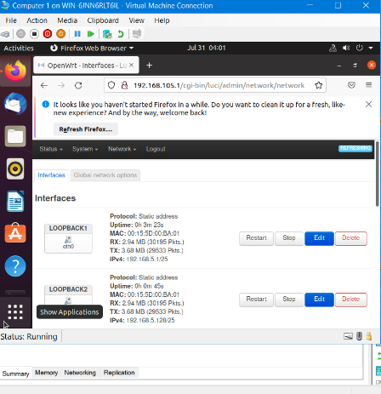
Loopback Interfaces
This screenshot should show both Loopback1 and Loopback2 interfaces and their correct IPv4 addresses.

Slide 4
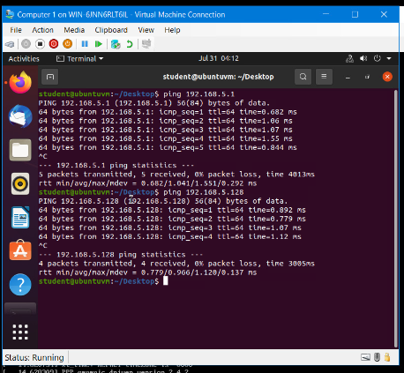
Connectivity Tests
This screenshot should show two successful ping tests from the Computer 1 VM to the Loopback 1 and Loopback 2 interfaces.

